Slide 1

Play:
Tic-Tac-Toe
Click to Continue
Action: Click on Click to Continue

Slide 2
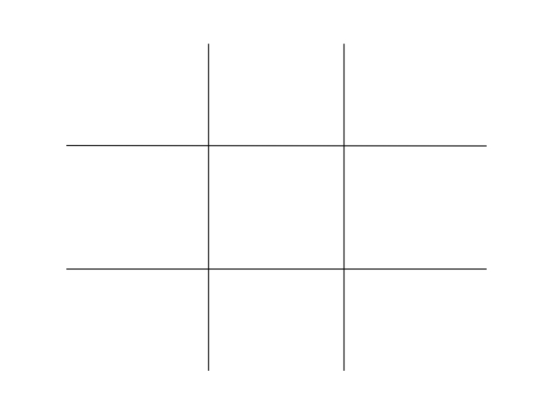

P1: Player 1 (X)
P2: Player 2 (O)
Player 1’s turn:
Action: Player 1 (X) makes first move.

Slide 3



P1: Player 1 (X)
P2: Player 2 (O)
Player 2’s turn:
Result: Player 1 (X) makes first move.
Action: Player 2 (O) makes first move.

Slide 4



P1: Player 1 (X)
P2: Player 2 (O)
Player 1’s turn:
Result: Player 2 (O) makes first move.
Action: Player 1 (X) makes second move.

Slide 5





P1: Player 1 (X)
P2: Player 2 (O)
Player 2’s turn:
Result: Player 1 (X) makes second move.
Action: Player 2 (X) makes the second move.

Slide 6




P1: Player 1 (X)
P2: Player 2 (O)
Player 1’s turn:
Result: Player 2 (O) makes second move.
Action: Player 1 (X) makes the third move.

Slide 7









P1: Player 1 (X)
P2: Player 2 (O)
Player 2’s turn:
Result: Player 1 (X) makes third move.
Action: Player 2 (O) makes the third move.

Slide 8








P1: Player 1 (X)
P2: Player 2 (O)
Player 1’s turn:
Result: Player 2 (O) makes third move.
Action: Player 1 (X) makes fourth move.

Slide 9









P1: Player 1 (X) ~> WINNER!
P2: Player 2 (O)
*Player 1 Wins the Game*
Start new Game
Result: Player 1 wins the game
Action: The option to start new game is presented.
→ Scoreboard Update

Slide 10










EX Tie:
P1: Player 1
P2: Player 2
Result: Tie
Start new Game
Result: Tie Game
Action: The option to start new game is presented.

